Slide 1


Slide 2

What is Spring?
Spring is the most popular application development framework for enterprise Java™.
Millions of developers use Spring to create high performing, easily testable, reusable code without any lock-in.
http://youtu.be/lEBp6E9aEEU

Slide 3
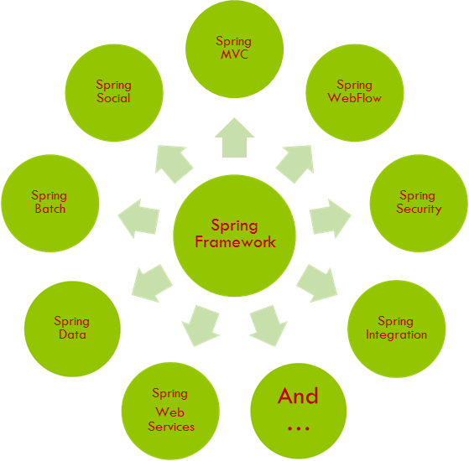
The Spring Framework

Slide 4
The Spring Framework - Goals
make the common tasks easier
promote good programming practice
you can focus on the domain problems

Slide 5
What is Spring Framework?
an open source application framework
a lightweight solution for enterprise applications
non-invasive (POJO based)
is modular
extendible for other frameworks
de facto standard of Java Enterprise Application

Slide 6
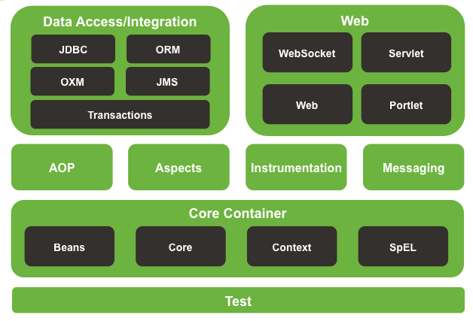
Spring Framework Runtimes

Slide 7
Core Container
Core and Beans
provide the fundamental parts of the framework, including IoC and Dependency Injection features. The BeanFactory is a sophisticated implementation of the factory pattern. It removes the need for programmatic singletons and allows you to decouple the configuration and specification of dependencies from your actual program logic.
Expression
provides a powerful expression language for querying and manipulating an object graph at runtime. It is an extension of the unified expression language (unified EL).

Slide 8
Core Container
Context
it is a means to access objects in a framework-style manner that is similar to a JNDI registry. The Context module inherits its features from the Beans module and adds support for internationalization (using, for example, resource bundles), event propagation, resource loading, and the transparent creation of contexts by, for example, a Servlet container. The Context module also supports Java EE features such as EJB, JMX, and basic remoting. The AplicationContext interface is the local point of the Context module.

Slide 9
AOP, Aspect, Instrumentation
AOP
provides an AOP Alliance-compliant aspect-oriented programming implementation allowing you to define, for example, method-interceptors and pointcuts to cleanly decouple code that implements functionality that should be separated
Aspect
provides integration with AspectJ
Instrumentation
provides class instrumentation support and classloader implementations to be used in certain application servers

Slide 10
Data Access/Integration
JDBC
provides a JDBC-abstraction layer
ORM
provides integration layers for popular object-relational mapping APIs, including JPA, JDO, Hibernate and iBatis
OXM
provides an abstraction layer that supports Object/XML mapping implementations for JAXB, Castor, XMLBeans, JiBX and XStream.

Slide 11
Data Access/Integration
JMS
contains features for producing and consuming messages. Since Spring Framework 4.1, it provides integration with the Messaging module
Transaction
supports programmatic and declarative transaction management

Slide 12
WEB
Spring’s WEB
provides basic web-oriented integration features
WEB-MVC
also known as the Web-Servlet module, contains Spring’s model-view-controller (MVC) implementation for web applications. Spring’s MVC
WEBMVC-Portlet
Also know as Web-Servlet module, provides the MVC implementation to be used in a portlet environment

Slide 13
Test
The spring-test module supports the unit testing and integration testing of Spring components with JUnit or TestNG.
It provides consistent loading of Spring ApplicationContexts and caching of those contexts. It also provides mock objects that you can use to test your code in isolation.

Slide 14
What is IoC?
In software engineering, inversion of control (IoC) describes a design in which custom-written portions of a computer program receive the flow of control from a generic, reusable library.
A software architecture with this design inverts control as compared to traditional procedural programming: in traditional programming, the custom code that expresses the purpose of the program calls into reusable libraries to take care of generic tasks, but with inversion of control, it is the reusable code that calls into the custom, or task-specific, code.

Slide 15
What is IoC?
Inversion of control is used to increase modularity of the program and make it extensible and has applications in object-oriented programming and other programming paradigms.
The term was popularized by Robert C. Martin and Martin Fowler.
The term is related to but different from the dependency inversion principle, which concerns itself with decoupling dependencies between high-level and low-level layers through shared abstractions.

Slide 16
What is IoC?
Inversion of control carries the strong connotation that the reusable code and the problem-specific code are developed independently even though they operate together in an application.
Software frameworks, callbacks, schedulers, event loops and dependency injection are examples of design patterns that follow the inversion of control principle, although the term is most commonly used in the context of object-oriented programming.

Slide 17
What is IoC?
Inversion of control serves the following design purposes:
To decouple the execution of a task from implementation.
To focus a module on the task it is designed for.
To free modules from assumptions about how other systems do what they do and instead rely on contracts.
To prevent side effects when replacing a module.
Inversion of control is sometimes facetiously referred to as the "Hollywood Principle: Don't call us, we'll call you".

Slide 18
What is DI?
Dependency injection is a software design pattern that implements inversion of control and allows a program design to follow the dependency inversion principle. The term was coined by Martin Fowler.

Slide 19
What is DI?
An injection is the passing of a dependency (a service) to a dependent object (a client). The service is made part of the client's state. Passing the service to the client, rather than allowing a client to build or find the service, is the fundamental requirement of the pattern.
Exist in two major variants
setter injection
constructor injection

Slide 20
What is DI? Setter injection
public class TextEditor { private SpellChecker spellChecker; // a setter method to inject the dependency. public void setSpellChecker(SpellChecker spellChecker) { System.out.println("Inside setSpellChecker." ); this.spellChecker = spellChecker; } // a getter method to return spellChecker public SpellChecker getSpellChecker() { return spellChecker; } public void spellCheck() { spellChecker.checkSpelling(); } }
public class SpellChecker { public SpellChecker(){ System.out.println("Inside SpellChecker constructor." ); } public void checkSpelling(){ System.out.println("Inside checkSpelling." ); } }

Slide 21
What is DI? Setter injection
import org.springframework.context.ApplicationContext; import org.springframework.context.support.ClassPathXmlApplicationContext; public class MainApp { public static void main(String[] args) { ApplicationContext context = new ClassPathXmlApplicationContext("Beans.xml"); TextEditor te = (TextEditor) context.getBean("textEditor"); te.spellCheck(); } }

Slide 22
What is DI? Setter injection
<?xml version = "1.0" encoding = "UTF-8"?> <beans xmlns = "http://www.springframework.org/schema/beans" xmlns:xsi = "http://www.w3.org/2001/XMLSchema-instance" xsi:schemaLocation = "http://www.springframework.org/schema/beans http://www.springframework.org/schema/beans/spring-beans-3.0.xsd"> <!-- Definition for textEditor bean using inner bean --> <bean id = "textEditor" class = "com.tutorialspoint.TextEditor"> <property name = "spellChecker"> <bean id = "spellChecker" class = "com.tutorialspoint.SpellChecker"/> </property> </bean> </beans>

Slide 23
What is DI? Constructor injection
public class TextEditor { private SpellChecker spellChecker; public TextEditor(SpellChecker spellChecker) { this.spellChecker = spellChecker; } }

Slide 24
What is DI? Advantages
Reduced dependencies: eliminate/reduce unnecessary dependencies
More reusable code in different context
More testable code: mock injection
More readable code: move dependencies to the interface of components: centralized
Reduced dependency carrying: parameters not needed

Slide 25
DI with Spring Boot
@RestController
@RequestMapping("/product")
public class ProductRESTService {
@Autowired
private ProductService productService;
public void createProduct(ProductDTO product) {
…
productService.persist(product);
...
}

Slide 26
IoC vs DI vs Factory
DI it is specific type of IoC
The Factory pattern’s main concerns is creating
The DI’s main concern is how things are connected together
DI related to Factory and Strategy patterns, but mostly resembles to Build Pattern

Slide 27
Spring Beans
The objects that form the backbone of your application and that are managed by the Spring IoC container are called beans. A bean is an object that is instantiated, assembled, and otherwise managed by a Spring IoC container. These beans are created with the configuration metadata that you supply to the container. For example, in the form of XML <bean/> definitions which you have already seen in the previous chapters.

Slide 28
Spring Beans - XML configuration
Model
package writer; public interface IWriter { public void write(String message); }
public class SimpleWriter implements IWriter { public void write(String message) { System.out.println(message); } }
public class NiceWriter implements IWriter { public void write(String message) { System.out.println("The string is " + s); } }
package client; import writer.IWriter; public class WriterClient { private IWriter writer; public void setWriter(IWriter writer) { this.writer = writer; } public void run() { writer.write("This is my test"); } }

Slide 29
Spring Beans - XML configuration
Configuration
<beans xmlns="http://www.springframework.org/schema/beans" xmlns:xsi="http://www.w3.org/2001/XMLSchema-instance" xmlns:aop="http://www.springframework.org/schema/aop" xmlns:context="http://www.springframework.org/schema/context" xsi:schemaLocation="http://www.springframework.org/schema/beans http://www.springframework.org/schema/beans/spring-beans-2.5.xsd http://www.springframework.org/schema/aop http://www.springframework.org/schema/aop/spring-aop-2.5.xsd http://www.springframework.org/schema/context http://www.springframework.org/schema/context/spring-context-2.5.xsd"> <bean id="writer" class="writer.NiceWriter" /> <bean id="writerClient" class="client.WriterClient"> <property name="writer" ref="writer" /> </bean> </beans>

Slide 30
Spring Beans - XML configuration
Main
public class Main { public static void main(String[] args) { ApplicationContext context = new ClassPathXmlApplicationContext("writer.xml"); WriterClient writerClient = (WriterClient) context.getBean("writerClient"); writerClient.run(); } }

Slide 31
Spring Beans - Annotations
Model
package writer; public interface IWriter { public void write(String message); }
public class SimpleWriter implements IWriter { public void write(String message) { System.out.println(message); } }
@Service
public class NiceWriter implements IWriter { public void write(String message) { System.out.println("The string is " + s); } }
package client; import writer.IWriter; @Service
public class WriterClient { private IWriter writer;
@Autowired public void setWriter(IWriter writer) { this.writer = writer; } public void run() { writer.write("This is my test"); } }

Slide 32
Spring Beans - Annotations
Main
public class Main { public static void main(String[] args) { ApplicationContext context = new ClassPathXmlApplicationContext("writer.xml"); WriterClient writerClient = (WriterClient) context.getBean("writerClient"); writerClient.run(); } }

Slide 33
Spring Beans – Scopes
simple
singleton
prototype
runtime
thread
custom implementation
web-aware scopes (available only for web-aware ApplicationContext)
request
session
global session

Slide 34
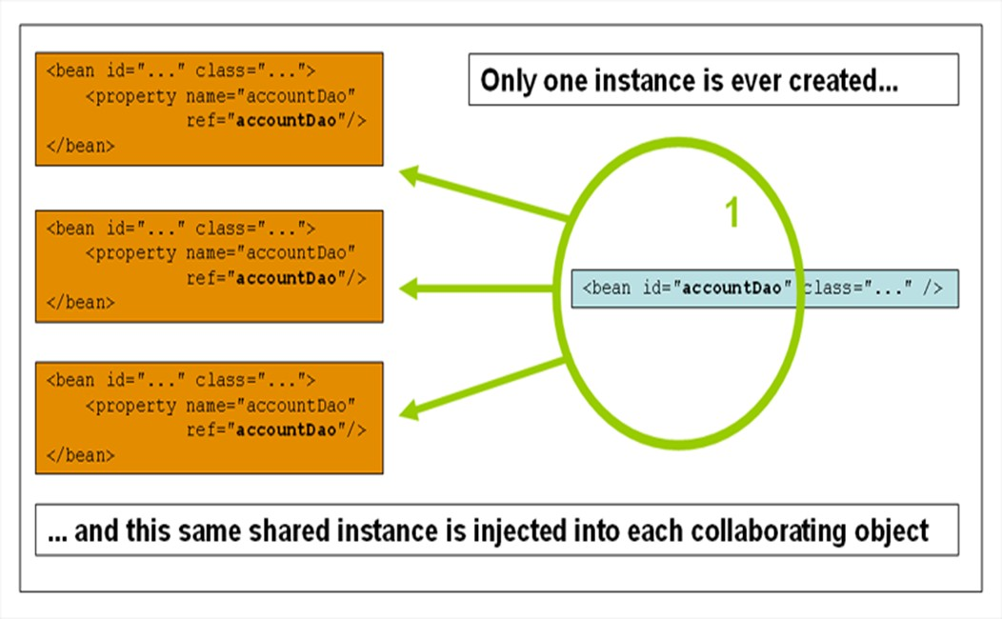
Spring Beans – The Singleton scope

Slide 35
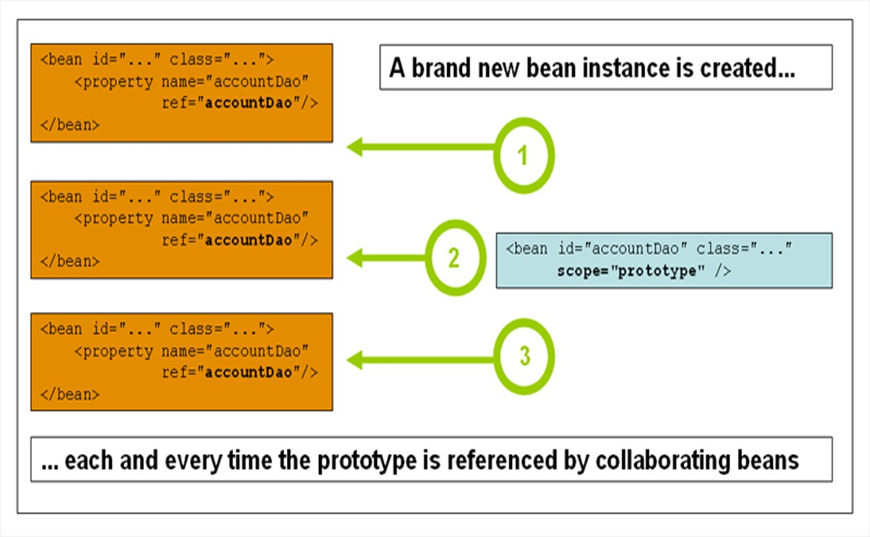
Spring Beans – The Prototype scope

Slide 36
Constructor-based DI
Is accomplished by the container invoking a constructor with a number of arguments, each representing a dependency
Calling a static factory method with specific arguments to construct the bean is nearly equivalent

Slide 37
Constructor argument resolution
argument resolution
<bean id="b1" class="org.examples.ClientServiceBean">
<constructor-arg ref="b2"/>
<constructor-arg ref="b3"/>
</bean>
argument type matching
<bean id="b2" class="ClientService" factory-method="getInstance">
<constructor-arg type="int" value="7500000"/>
<constructor-arg type="java.lang.String" value="42"/>
</bean>
argument index
<bean id="b3" factory-bean="factory" factory-method="getInstance"/>
<constructor-arg index="0" value="75"/>
<constructor-arg index="1" value="42"/>
</bean>

Slide 38
Setter-based DI
Is accomplished by the container calling setter methods on your beans after invoking a no- argument constructor or no-argument static factory method to instantiate bean

Slide 39
Constructor vs Setter
constructor
mandatory dependencies
immutability
setter
optional dependencies and default values
obvious names
auto inheritance

Slide 40
Null and empty values
<!-- is equivalent to the following
<bean class="Bean">
<property name="email" value=""/>
</bean>
code:
bean.setEmail("").-->
<!-- The <null/> element
<bean class="Bean">
handles null
values. -->
<property name="email"><null/></property>
</bean>

Slide 41
Spring Transaction
A transaction is a group of operations that executes as a unit of work, they execute all correctly or none of them.
A transaction should have a well known set of properties defined by the acronym ACID (Atomicity, Consistency, Isolation, Durability).

Slide 42
Spring Transaction
public class BookingService { @Autowired JdbcTemplate jdbcTemplate; @Transactional public void book(String... persons) { for (String person : persons) { log.info("Booking " + person + " in a seat..."); jdbcTemplate.update("insert into BOOKINGS(FIRST_NAME) values (?)", person); } }; public List<String> findAllBookings() { return jdbcTemplate.query("select FIRST_NAME from BOOKINGS", new RowMapper<String>() { @Override public String mapRow(ResultSet rs, int rowNum) throws SQLException { return rs.getString("FIRST_NAME"); } }); } }

Slide 43
Spring Transaction
public static void main(String[] args) { ApplicationContext ctx = SpringApplication.run(Application.class, args);
BookingService bookingService = ctx.getBean(BookingService.class); bookingService.book("Alice", "Bob", "Carol"); Assert.assertEquals("First booking should work with no problem", 3, bookingService.findAllBookings().size()); try { bookingService.book("Chris", "Samuel"); } catch (RuntimeException e) { log.info("v--- The following exception is expect because 'Samuel' is too big for the DB ---v"); log.error(e.getMessage()); } ...

Slide 44
Spring Transaction
for (String person : bookingService.findAllBookings()) { log.info("So far, " + person + " is booked."); } log.info("You shouldn't see Chris or Samuel. Samuel violated DB constraints, and Chris was rolled back in the same TX"); Assert.assertEquals("'Samuel' should have triggered a rollback", 3, bookingService.findAllBookings().size()); ...

Slide 45
Spring Transaction
try { bookingService.book("Buddy", null); } catch (RuntimeException e) { log.info("v--- The following exception is expect because null is not valid for the DB ---v"); log.error(e.getMessage()); } for (String person : bookingService.findAllBookings()) { log.info("So far, " + person + " is booked."); } log.info("You shouldn't see Buddy or null. null violated DB constraints, and Buddy was rolled back in the same TX"); Assert.assertEquals("'null' should have triggered a rollback", 3, bookingService .findAllBookings().size()); }

Slide 46
Spring MVC
MVC is a software architectural pattern specifically designed for implementing user interfaces on computers. It structures the presentation logic into three main parts: the model, the view and the controller.
Controller: Handles input and converts it to commands for the model or view.
Model: Manages the data, logic and rules of the application.
View: Represents the output of information, many views of the same information are possible.

Slide 47
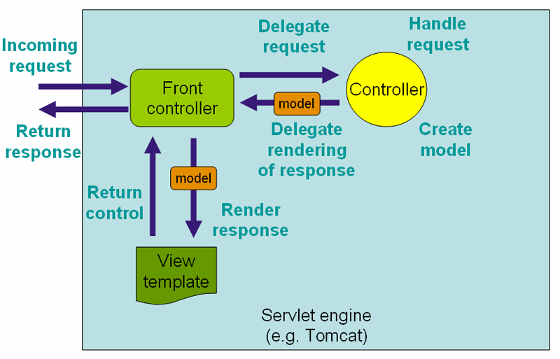
Spring MVC

Slide 48
Spring MVC
@Controller public class GreetingController { @RequestMapping("/greeting") public String greeting(@RequestParam(value="name", required=false, defaultValue="World") String name, Model model) { model.addAttribute("name", name); return "greeting"; } }

Slide 49
Spring MVC
<!DOCTYPE HTML> <html xmlns:th="http://www.thymeleaf.org"> <head> <title>Getting Started: Serving Web Content</title> <meta http-equiv="Content-Type" content="text/html; charset=UTF-8" /> </head> <body> <p th:text="'Hello, ' + ${name} + '!'" /> </body> </html>

Slide 50
Spring MVC
@SpringBootApplication public class Application { public static void main(String[] args) { SpringApplication.run(Application.class, args); } }

